Slide 1
A JOINT APPROACH
TO GUIDE A GROWING BALTIC CITY INTO A GREAT BALTIC CITY
Rostock May 14th - 17th, 2017
UBC Commissions & Interreg Project Network JOHANN

Slide 2
in search of a new city
Michel Sudarskis
Secretary General
INTA – International Urban Development Association

Slide 3
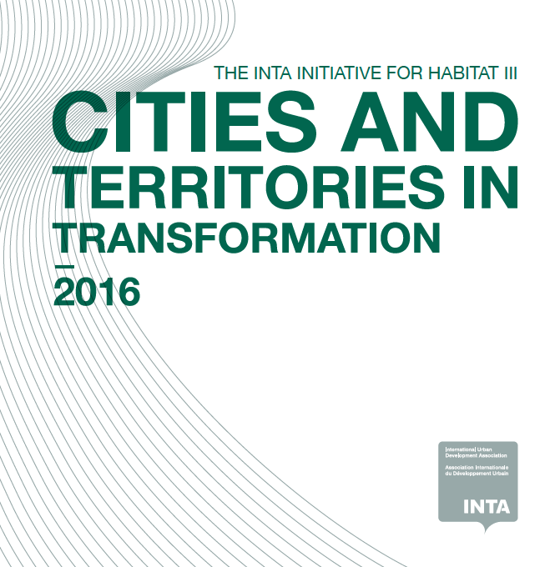
INTA Initiative for Cities in Transformation
A contribution to UN Habitat 3rd conference
A report that identifies the changes to come, all of which are unavoidable challenges.
Areas for action on key urban policies and which instruments are available to accompany the transformation
A joint programme to implement in concrete urban situations the global principles set by the NUA, GDGs, Cops

Slide 4
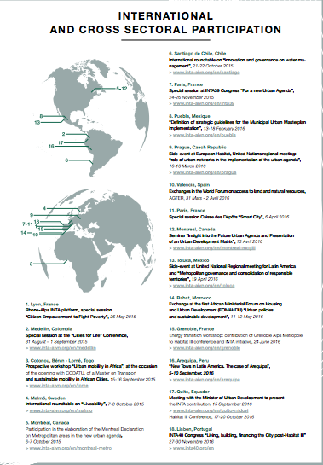
International and cross sectoral participation

Slide 5
From growing to great city
There is no longer a single city model but
cities do have common features
and face common challenges
Focus is on the factors, other than technology, that make city liveable such as the implementation process, and the necessary coproduction with all stakeholders

Slide 6
EU cities do have common features
A strong relation to natural assets: river, sea, mountains, plains, forests. It is only recently that cities have been disconnected from their natural environment
A genuine sense of mix development: mixing functions with a variety of urban forms
A long social and economic history (industrial period) that shaped the contemporary cities
Well designed "void" – emptiness that become "public spaces and places" connecting rich urban forms dating back to centuries with contemporary needs
Notes:
Sienna or Florence plaza, the English parks, the Spanish ramblas, St Marc square, Barcelona Diagonal by Serra, Haussmann making specification of how to build the corners of the streets but letting the architects to fill the void in between, the Roman cardo, etc

Slide 7
Common challenges and constraints
Provision of affordable, adaptable and flexible housing
Land price, cost of construction, regulatory and norms hindrances, modes of tenures, shift from free-hold property to lease-based real estate economy,,,
Local governance
Integration of multiple levels and perimeters: city centre, periphery, rural environments, metropolitan process, regional leadership
Proximity vs higher level of governance, participation of plurality of actors
Protection of agricultural land
Spatial solidarity, limiting unequal redistribution of wealth between territories belonging to same urban system

Slide 8
Common challenges and constraints
Impacts of ICT technology and innovation on urban services
Health, retail, tourism, basic services, public participation, "smart" movement, private sector engagement in managing urban process, questioning the technology imperative
Reindustrialisation of the city
From industry to knowledge, productive economy back to the city, jobs for all – young and aged
Limited operating capacity to deal with complexity
Reduced public sector funding, dynamic effects not taken into account by planning, insufficient technical competences and negotiating skills with private sector, the short life of city leaders (lack of consistency over time), inadequate financial development tools, …
Identifying the problem does not mean finding a solution
Notes:
Poor urban management locks in lower productivity, higher emissions, and socail costs

Slide 9
What to do to "produce" the city of tomorrow
Change the scale of strategic thinking by broadening the city scope:
better integration of internal and external flows (financial, material, energy, knowledge, data, skills, etc.)
evaluation of positive or negative externalities at different territorial levels for the same project at the price of instability and complexity
more inclusive identification of the chain of urban agents: next to planners, architects, contractors, investors, real estate brokers, notaries…give place to households, volunteers, biodiversity, etc. And the city itself is not a mere recipient of economic activity, but an economic system as such.

Slide 10
What to do to "produce" the city of tomorrow
Rethink planning and development by focusing on the usages and services needed by the population. Need of more strategic facilitation
Give place to innovation in particular social innovation through cooperative and collaborative approaches (horizontal versus vertical process)
As the city become more complex (issues), diverse (actors), facing more constraints (financing plus national and EU regulations) and general uncertainty (political and economic instability, legal appeals) to give chance to more flexibility and adaptation by temporary and transitory urbanism (prefiguration)

Slide 11
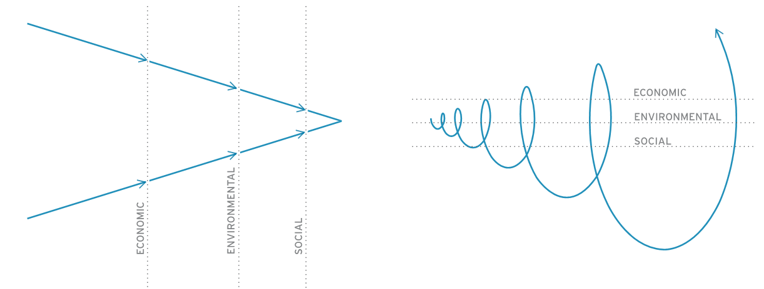
Integrated urban systems design/planning and procurement for sustainability and resilience
Now
Where we could be with systems thinking and performance based procurement
DEVELOPMENT
PLANNING
DESIGN
DESIGN
PLANNING
DEVELOPMENT
Sequential and silo approach – conventional economic assessment dominates how we design (cities, policies, technology interventions, etc)
Short-term political and finance cycles dominate economic planning
Environment plan in silo (i.e. water-food-energy, urban and rural viewed separately)
Social benefit at the end of the line – abstract relationship to earlier plans
INTEGRATED DESIGN
INTEGRATED PLANNING
ACCELERATED DEVELOPMENT

Slide 12
Where to turn for inspiration?
Social innovation
How the diffusion of organisations based on sharing, exchange, and participation on a neighbourhood scale can regenerate the social fabric, restore relations of proximity and create meaningful bonds between individuals
Greater collaboration of individuals amongst themselves, collaborative services, mutual assistance, shared usage can reduce significantly each individual’s needs in terms of products and living space and optimize the use of equipment, reduce travel distances and, finally, lessen the impact of our daily lives on the environment
Notes:
Medellin Charter
Well being compact, intelligent, human and green
Nordic Models
Greater collaboration of individuals amongst themselves, Collaborative Services, mutual assistance, shared use can reduce significantly each individual’s needs in terms of products and living space and optimize the use of equipment, reduce travel distances and, finally, lessen the impact of our daily lives on the environment

Slide 13
Where to turn for inspiration?
Latin America: equity and cultural integration
Sharing principles (equity, interdependence, non-violence, innovation, participation and transparency, plurality, sustainability, coherence-cohesion, rights, …) and values (freedom, autonomy, tolerance, respect, trust, credibility, comprehensive security, co-responsibility and peace)
Aesthetics as an ethical position, urban design as expression of cultural diversity and citizenship
Baltic and Nordic cities: sustainability was invented there!
Non dogmatic approach to sustainability, innovative responses to global challenges
Genuine concern for the well being of the people, putting people, values, community, welfare and democracy at the center of the urban culture
High level of expertise in environmental development, nature as an asset more than a commodity
Aesthetics and urban design as expression of innovation

Slide 14
Looking for greater cooperation
INTA gathers since 40 years cities and territories, and public private practitioners round the world to share knowledge and experiences
INTA had accompanied Rostock (many small steps) since the beginning of the 1990's in its transformation.
Your Region is already a frontrunner in the global urban and territorial context.
Lets join together in accompanying other "places" and Regions, in Europe but also in the rest of the world, in their transformation focusing on the priorities evoked earlier

Slide 15
THANK YOU
www.inta-aivn.org

